Slide 1

I am a Software Engineer.
Coder
Programmer
Developer
Problem Solver!

Slide 2
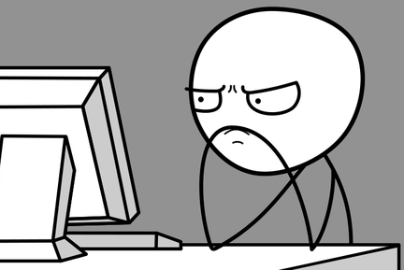

What do I do everyday?
Fix Old / Broken Code
Read More Code
Write New Code
Rubber
Duck
Start here
Read Code
Paired
Programming
Fix code I just wrote.
Test Code
Read Even More Code

Slide 3
What do I do every day?
Ask Questions
Solve Problems

Slide 4
What does code look like?

Slide 5
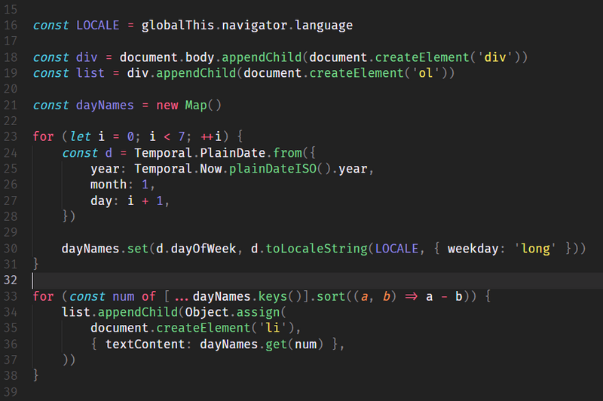
Fancy Decision Making
Let’s write some code!

Slide 6


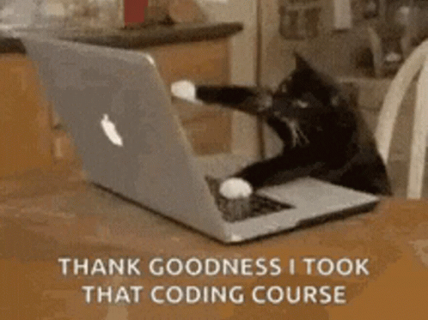
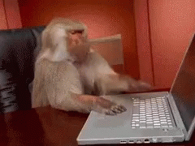
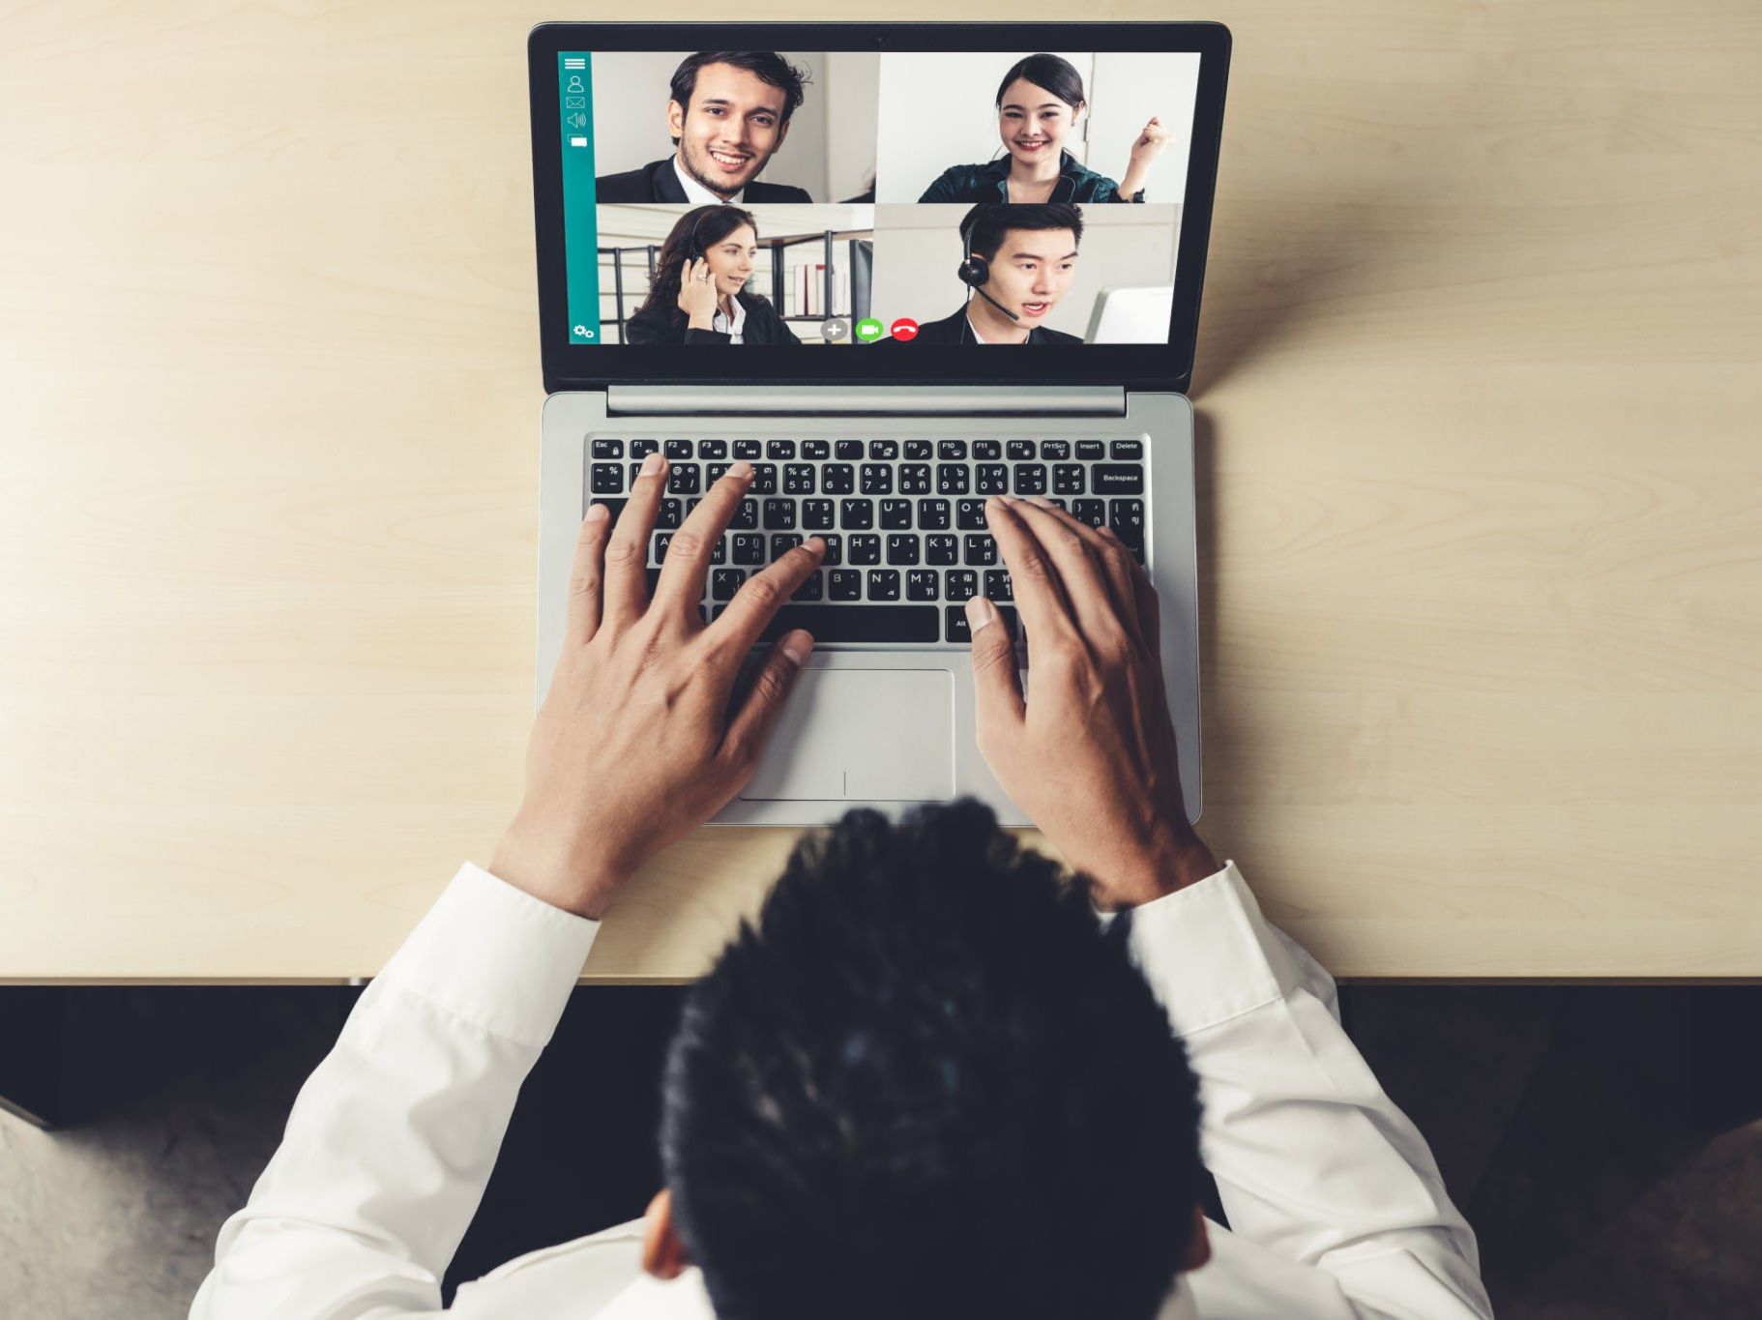
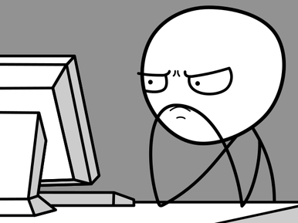
How I got here
Played with computers
Had a career in broadcast
Coding bootcamp
Made stuff
Interview and technical test
Keep learning and practicing
Notes:
Played with computers.
Broadcast Engineer for 18 years.
Coding Bootcamp for 3 months.
Make Stuff - websites, apps, the diabetes calculator.
Interview and a technical test.
Some people go to uni and study CompSci

Slide 7
What you need
A love of problem solving.
A willingness to read and learn.
Teamwork and communication.
What you don’t need
A degree*.
To know everything.
To be neurotypical.
An office to work in.
*It depends.
Notes:
What you need:
A love of problem solving. Attention to detail and patterns will help.
Willingness to read and learn, forever. Technology changes so fast, but take it as an opportunity to play with new toys when work will pay for it.
Teamwork. The only job I could think of that doesn’t require teamwork is a writer or an artist.
Communication. Explain complex things in a simple way; don’t treat people like fools even if you are the cleverest person in the room.
What you don’t need:
A degree, unless you plan on building a physics engine or to work in the sciences. Universities are also a fantastic way to find out more about a subject you love, I would love to go and study a Computer Science degree because I’m curious but not because I need it to do my job.
To know everything. No one knows everything.
Neurotypical - there are so many different ways to learn and to code, every one of us does it differently. The best programmer I know, she has ADHD, but she is able to think like lightning when it came to writing code.
An office. You can work from home. I get to spend more time with the people I love after travelling all over the country.

Slide 8
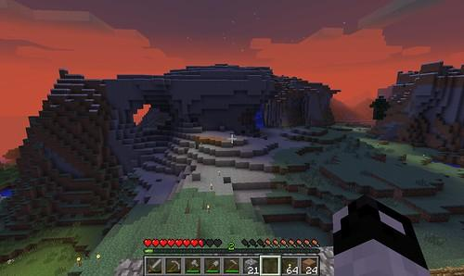
Interested?
Learn stuff.
Make stuff.
Break stuff.
Fix stuff.
Now ask me stuff.

